Slide 1


Slide 2
Chapter 6
Product Design and Process Selection – Services

Slide 3
OBJECTIVES
Service Generalizations
Service Strategy: Focus & Advantage
Service-System Design Matrix
Service Blueprinting
Service Fail-safing
Characteristics of a Well-Designed Service Delivery System
Notes:
2

Slide 4

Service Generalizations
1. Everyone is an expert on services
2. Services are idiosyncratic
3. Quality of work is not quality of service
4. Most services contain a mix of tangible and intangible attributes
Notes:
3

Slide 5
Service Generalizations (Continued)
5. High-contact services are experienced, whereas goods are consumed
6. Effective management of services requires an understanding of marketing and personnel, as well as operations
7. Services often take the form of cycles of encounters involving face-to-face, phone, Internet, electromechanical, and/or mail interactions
Notes:
4

Slide 6
Service Businesses
Defined
A service business is the management of organizations whose primary business requires interaction with the customer to produce the service
Facilities-based services: Where the customer must go to the service facility
Field-based services: Where the production and consumption of the service takes place in the customer’s environment
Notes:
5

Slide 7
Internal Services
Defined
Internal services is the management of services required to support the activities of the larger organization. Services including data processing, accounting, etc
Internal Supplier
Internal
Customer
External
Customer
Internal Supplier
Notes:
6

Slide 8
The Service Triangle
Exhibit 6.1
The Service
Strategy
A philosophical view that suggests the organization exists to serve the customer, and the systems and the employees exist to facilitate the process of service.
The
Customer
The
Systems
The
People
Notes:
7

Slide 9
Applying Behavioral Science to Service Encounters
The front-end and back-end of the encounter are not created equal
Segment the pleasure, combine the pain
Let the customer control the process
Pay attention to norms and rituals
People are easier to blame than systems
Let the punishment fit the crime in service recovery
Notes:
8

Slide 10
Service Strategy: Focus and Advantage
Performance Priorities
Treatment of the customer
Speed and convenience of service delivery
Price
Variety
Quality of the tangible goods
Unique skills that constitute the service offering
Notes:
8

Slide 11
Service-System Design Matrix
Exhibit 6.7
Degree of customer/server contact
Buffered
Permeable
Reactive
High
core (none)
system (some)
system (much)
Low
Face-to-face
total
customization
Face-to-face
loose specs
Sales
Opportunity
Face-to-face
tight specs
Production
Efficiency
Phone
Contact
Internet &
on-site
technology
Mail contact
Low
High
Notes:
9

Slide 12
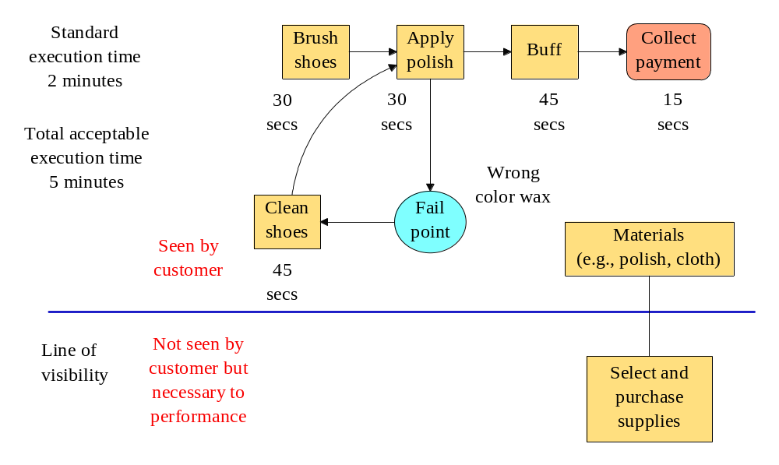
Example of Service Blueprinting
Notes:
11

Slide 13
Service Fail-safing
Poka-Yokes (A Proactive Approach)
Keeping a mistake from becoming a service defect
How can we fail-safe the three Ts?
Task
Treatment
Tangibles
Notes:
13

Slide 14
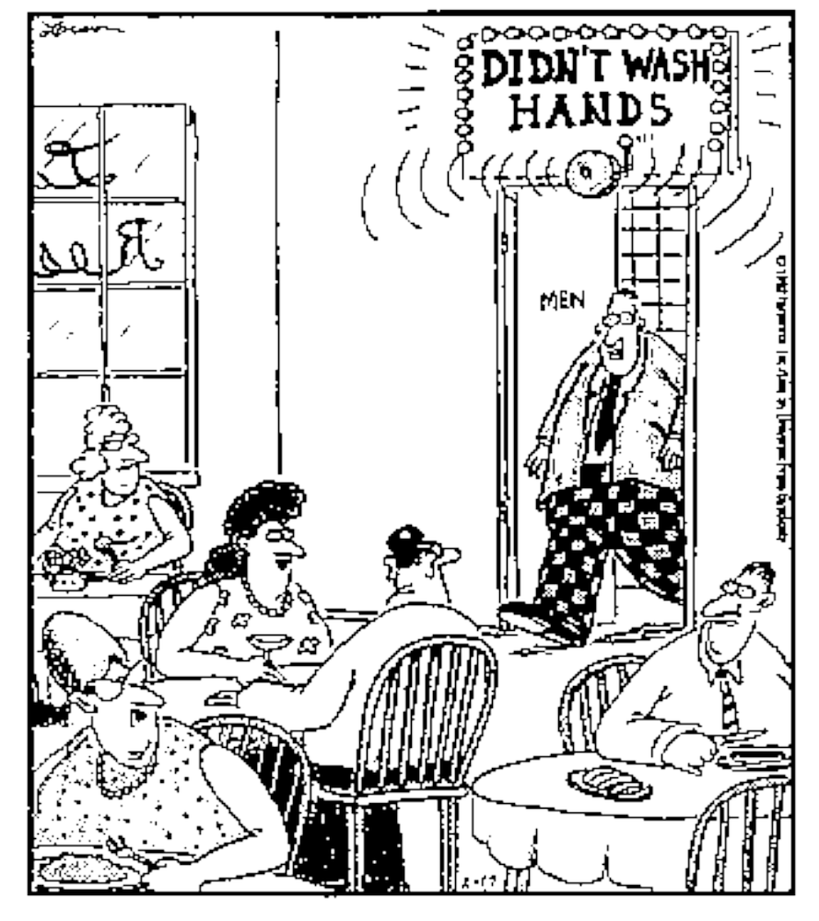
Have we compromised one of the
3 Ts?
Task
Treatment
Tangible
Notes:
14

Slide 15
Three Contrasting Service Designs
The production line approach (ex. McDonald’s)
The self-service approach (ex. automatic teller machines)
The personal attention approach (ex. Ritz-Carlton Hotel Company)
Notes:
15

Slide 16
Characteristics of a Well-Designed Service System
1. Each element of the service system is consistent with the operating focus of the firm
2. It is user-friendly
3. It is robust
4. It is structured so that consistent performance by its people and systems is easily maintained
Notes:
17

Slide 17
Characteristics of a Well-Designed Service System (Continued)
5. It provides effective links between the back office and the front office so that nothing falls between the cracks
6. It manages the evidence of service quality in such a way that customers see the value of the service provided
7. It is cost-effective
Notes:
18

Slide 18
End of Chapter 6

